Slide 1
Design and Analysis of Algorithms
CS345A
Lecture 30
Amortized Analysis – III
Dynamic Tables (insertion as well deletion)
A magical application

Slide 2
RECAP of Last Lecture

Slide 3





Amortized Analysis of Insert($x$)
When we discard the current table, we copy $n$ elements into a new table (spending O($n$) time).
However, from the moment we created the table to the moment we discarded the table,
we performed $\frac{n}{2}$ insertions. There insertions pay for this costly operation of copying $n$ elements
➔ O($1$) amortized time per insertion
$$n/2$$
$$n/2$$
$n$ copy operations

Slide 4





Amortized Analysis of Delete($x$)
When we discard the current table, we copy $n$ elements into a new table (spending O($n$) time).
However, from the moment we created the table to the moment we discarded the table,
we performed $n$ deletions. There deletions pay for the costly operation of copying $n$ elements.
➔ O($1$) amortized time per deletion.
$$2n$$
$$n$$
$n$ copy operations

Slide 5
SPACE and TIME Efficient Dynamic Table
For handling insertions and deletions both

Slide 6







Attempt 1
“just use the insertion/deletion procedures since we spent so much time on them”.
there is a serious problem in this combination
$$2m$$
$$x$$
$$m+1$$
Delete($x$)
Each operation requires $Θ(m)$ time ☹
Insert($x$)
$$m$$

Slide 7
So there is no point in carrying out amortized analysis of the “Attempt 1” algorithm.
Instead we need to have a new algorithm.

Slide 8
Towards designing new algorithm
Our original algorithm which handles insertions has some novelty.
So let us try to extend it to handle deletions.
How should this extension look like ?
Spend some time thinking over it.

Slide 9






An efficient way to perform delete($x$)
Delete $x$ into $T$;
$n$← $n−1$;
If ($n=0$)
FreeTable($T$);
Else
If($n=$ size($T$)/2 )
{ $T′$← CreateTable($n$);
Copy($T$,$T′$);
FreeTable($T$);
$T$← $T′$;
}
size($T$)/4
// Table is quarter full !
($2n$);
O($1$)
O($n$)
O($1$)
Idea:
Delay the shrinking

Slide 10


The intuition behind the new algorithm
Observation: Every time a table is created, it is half-full.
Only two big events can happen in future:
It becomes full
It becomes quarter full
➔ At least $n$ insertions
➔ At least $n/2$ deletions

Slide 11

Amortized Analysis of Delete($x$)
$$4m$$
$φ$=$c$ ($2m−2$)
$$x$$
Before Delete($x$)
$$m+1$$
After Delete($x$)
$φ$ = $0$
$$2m$$
Operation Delete($x$) | Actual Cost | $$Δ(φ)$$ | Amortized Cost
Case 1: when table does not shrink
$$c$$
$$2c$$
$$3c$$
Case 2: when table shrinks to half
$$cn+c$$
$$c(2−2n)$$
$$<3c$$
$$3c−cn$$
$φ$ used by us for handling insertion = $c$ ($2n−$ size($T$))
Look carefully the Case 2.
How to adapt this $φ$ so that amortized cost is bounded by a constant for deletion as well.

Slide 12
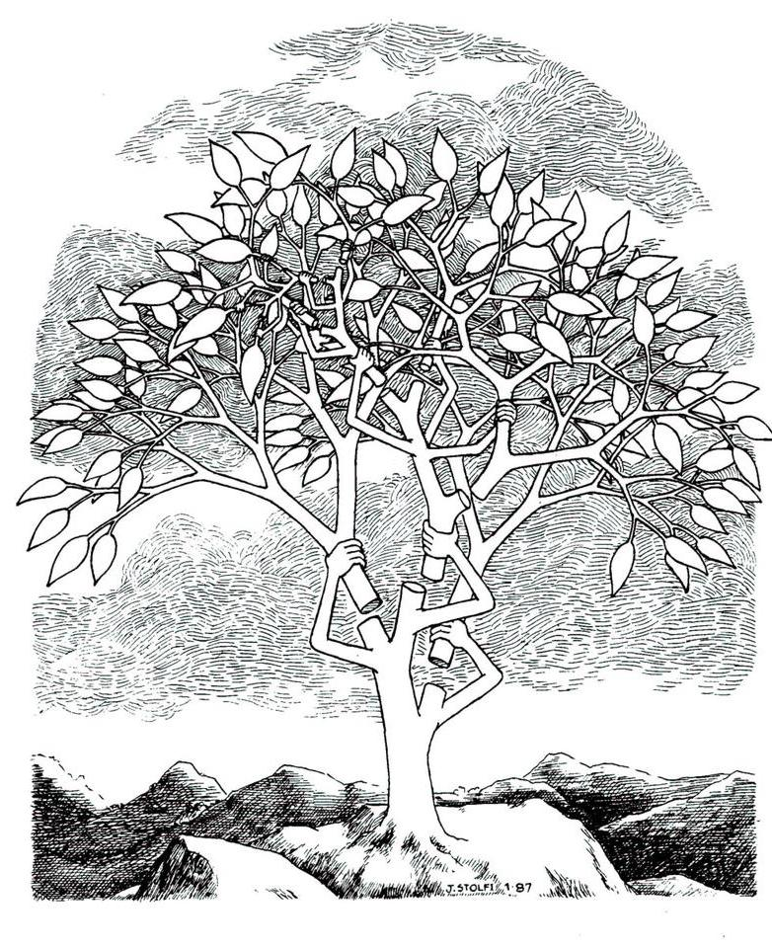

Splay tree: A self organizing Binary search trees.
JACM $1985$

Slide 13



A magic
In order to show why splay trees work so well,
we shall discuss a simpler but still a very challenging problem.
Any arbitrary BST on $n$ keys
Any arbitrary $m$search operations
Time taken : ??????
O(($m+n$) log $(m+n)$).

Slide 14
Self Organizing LIST
A nice problem to realize the
magical power of amortized analysis

Slide 15
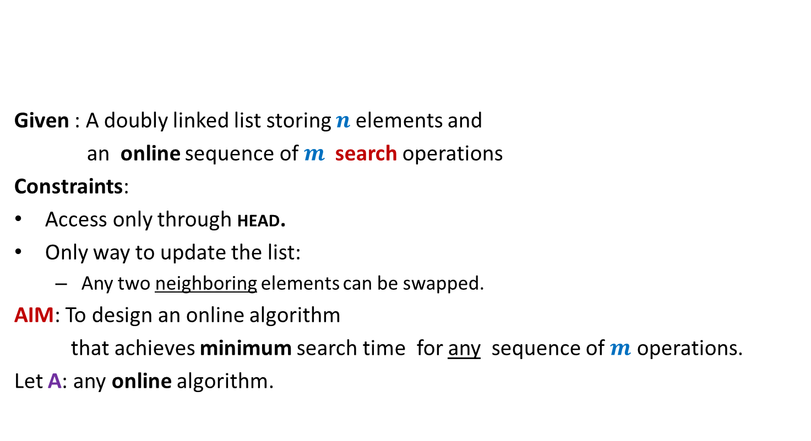
Problem : Online list search
HEAD
Given : A doubly linked list storing $n$elements and
an online sequence of $m$ search operations
Constraints:
Access only through HEAD.
Only way to update the list:
Any two neighboring elements can be swapped.
AIM: To design an online algorithm
that achieves minimum search time for any sequence of $m$ operations.
Let A: any online algorithm.
P
A
N
K
R
U
I
How to judge the efficiency of algorithm A ?

Slide 16
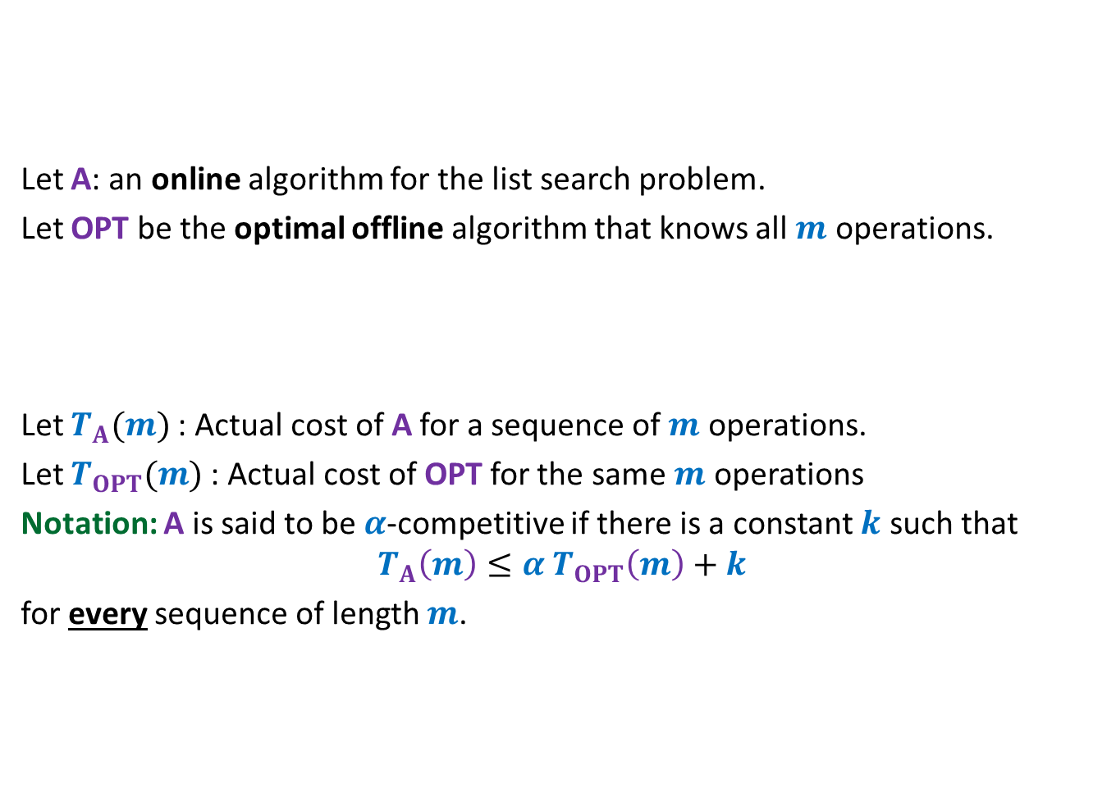
Competitive ratio
A tool to analyze any online algorithm
HEAD
Let A: an online algorithm for the list search problem.
Let OPT be the optimal offline algorithm that knows all $m$ operations.
Let $T_{A}(m)$: Actual cost of A for a sequence of $m$ operations.
Let $T_{OPT}(m)$: Actual cost of OPT for the same $m$ operations
Notation: A is said to be $α$-competitive if there is a constant $k$ such that
$$T_{A}\left(m\right)≤{α T}_{OPT}\left(m\right)+k$$
for every sequence of length $m$.
P
A
N
K
R
U
I
How well does A compete with OPT
for any sequence ?

Slide 17
Competitive ratio
A tool to analyze any online algorithm
HEAD
Let A: an online algorithm for the list search problem.
Let OPT be the optimal offline algorithm that knows all $m$ operations.
Let $T_{A}(m)$: Actual cost of A for a sequence of $m$ operations.
Let $T_{OPT}(m)$: Actual cost of OPT for the same $m$ operations
Notation: A is said to be $α$-competitive if there is a constant $k$ such that
$$T_{A}\left(m\right)≤{α T}_{OPT}\left(m\right)+k$$
for every sequence of length $m$.
P
A
N
K
R
U
I

Slide 18
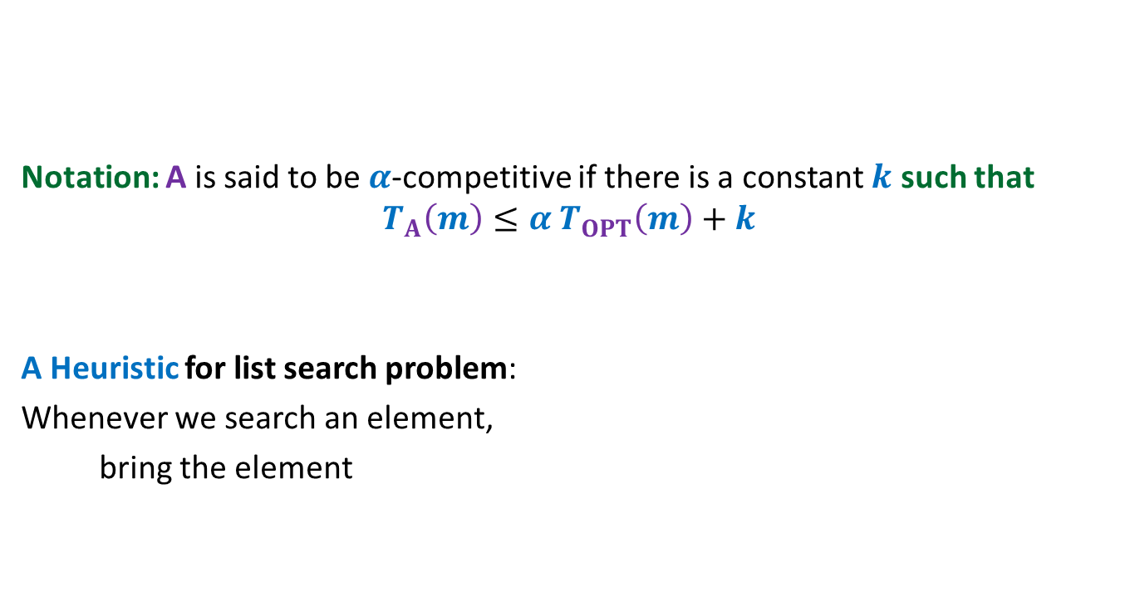
HEAD
Notation: A is said to be $α$-competitive if there is a constant $k$ such that
$$T_{A}\left(m\right)≤{α T}_{OPT}\left(m\right)+k$$
A Heuristic for list search problem:
Whenever we search an element,
bring the element
P
A
N
K
R
U
I
to the front of the list
after the search.

Slide 19
Move to Front Algorithm
Caution :
For a better understanding, please go slow
and take long pauses in the remaining slides.

Slide 20

Move-to-Front algorithm
HEAD
Search(e):
Starting from HEAD pointer, scan linearly till we find element e;
Bring the node storing e to the front of list
A notation:
$r$(e): rank of element e in the list.
P
A
N
K
R
U
I
by a sequence of swaps.
Example: Search(R)

Slide 21


Move-to-Front algorithm Execution of Search(R)
$r$(R) steps for locating R
$r$(R) $−1$ swaps
HEAD
P
A
N
K
R
U
I
HEAD
P
A
N
R
K
U
I
HEAD
P
A
R
N
K
U
I
HEAD
P
R
A
N
K
U
I
HEAD
R
P
A
N
K
U
I

Slide 22
How good is MTF Algorithm ?
MTF versus OPT

Slide 23
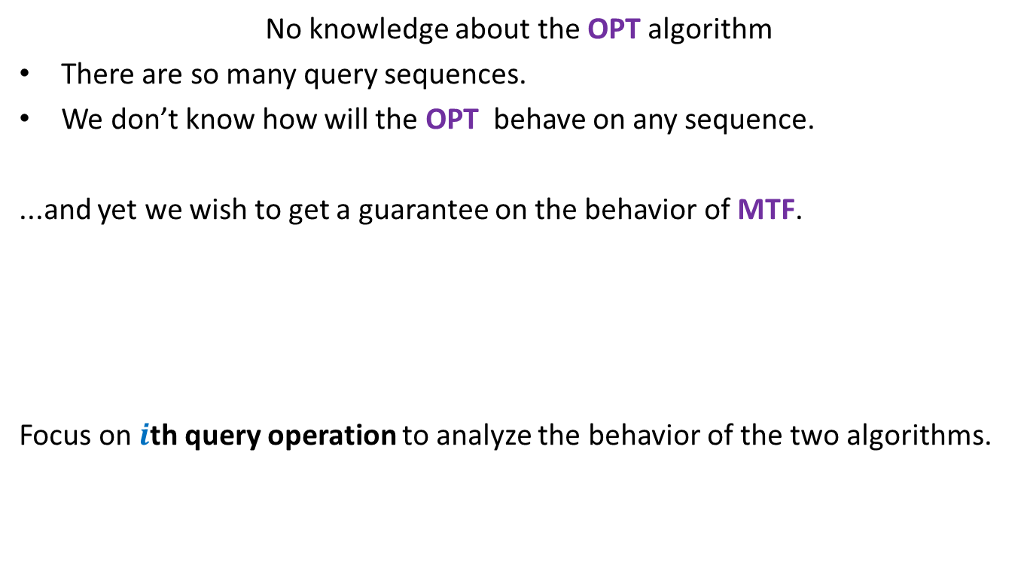
What is the main challenge ?
No knowledge about the OPT algorithm
There are so many query sequences.
We don’t know how will the OPT behave on any sequence.
...and yet we wish to get a guarantee on the behavior of MTF.
Focus on $i$th query operation to analyze the behavior of the two algorithms.
Doesn’t this goal look
impossible or unrealistic ?
But the world of algorithms is full of such magical results.
So think over “how should the analysis proceed?” for 10 minutes before you proceed

Slide 24







$i$th query operation of MTF and OPT
Let $i$th query operation be Search(x)
Actual cost of Search(x) in MTF algorithm : ?
Actual cost of Search(x) in OPT algorithm : ?
Our aim: To show that
the amortized cost of Search(x) in MTF algorithm is bounded in terms of $r^{∗}$(x) and$t_{i}$
➔ $φ$ should be such that $Δφ$must have “$−2r$(x)” term to nullify the actual cost.
HEAD
…
MTF list
1
2
…
$r$(x)$−1$
$r$(x)
…
x
What should be the potential function with this feature?
HEAD
OPT list
…
…
x
…
1
$r^{∗}$(x)
$2r$(x)$−$1
$r^{∗}$(x)$+ t_{i}$
No. of swaps by OPT

Slide 25


The potential function $φ$
The potential of the MTF algorithm after $i$ steps
$φ$($i$) = 2. # inversions
Inversions: {(E,C) , (E,A) , (E,D) , (E,B) , (D,B)}
$φ$($i$) = 10
Note: $φ$($0$)= $0$since two lists are same in the beginning.
and $φ$($i$) $≥0$ always.
➔ $φ$ is a valid potential function.
HEAD
E
C
A
D
B
MTF list
HEAD
C
A
B
D
E
OPT list

Slide 26
Spend good time
To use the potential function (given in the previous slide) to carry out amortized analysis of the MTF algorithm.
It will indeed be great to see at least some of you to do the complete analysis. But what is more important is that each one of you try sincerely and wholeheartedly.

